Slide 1
Migrate your SharePoint workflows to Power Automate
With migration tooling (preview)
By Zac Sun, Principal Product Manager of ODSP Migration
Notes:
Hello and welcome, everyone! My name is Zac Sun. I’m a Product Manager within the OneDrive and SharePoint Migration team. Today, I will introduce a preview feature that can help you migrate your legacy SharePoint workflows to Power Automate.

Slide 2

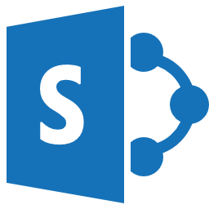

Modernize your legacy workflow
Power Automate is the new generation workflow engine in Microsoft365. We have released a new feature on top of SharePoint Migration Tool to support migrating SharePoint workflow to Power Automate.
SharePoint
Power Automate
Workflow
Migration Tool
Workflow, created by U1
Flow, owned by U1
Notes:
Just to give everyone a quick overview of today’s subject. We developed the workflow migration feature on top of SharePoint Migration Tool which has already supported SharePoint site and list migration. We did hear customers spent lots of effort to rebuild legacy workflow logic on Power Automate. We believe the new tool can save most of the manual work and automate the conversion process with the best practices.
The tool does a few things – query and fetch source workflow, parse the workflow definition, convert it to Power Automate flow, package the flow into a solution and publish the solution with Power Automate API.

Slide 3
What can you do with SPMT preview build
Using the SharePoint Migration Tool (SPMT), you can now migrate:
Public preview
SharePoint Server 2010 out of the box (OOTB) approval and collect feedback workflows to Power Automate.
List and library workflow, content-type workflow
Workflow definitions and associations (not workflow history data)
Private preview 1
SharePoint Server 2010 and 2013 Designer (SPD) workflows to Power Automate
Notes:
Let’s see what you can do with this new feature. In its public preview release, which is available to all, you can migrate 2010 OOTB Approval and Collect Feedback workflows to Power Automate. The tool can migrate list and library workflow as well as content-type workflow. It migrates workflow definition and the association to the list, but not the history data.
In the private preview, I will show you how to get it later, you can migrate Designer workflow, people also call it custom workflow. In the version 1, commonly-used workflow actions can be migrated. We will support more actions in upcoming versions.
Next, I will demonstrate how the tool migrates workflows in a SharePoint site.

Slide 4
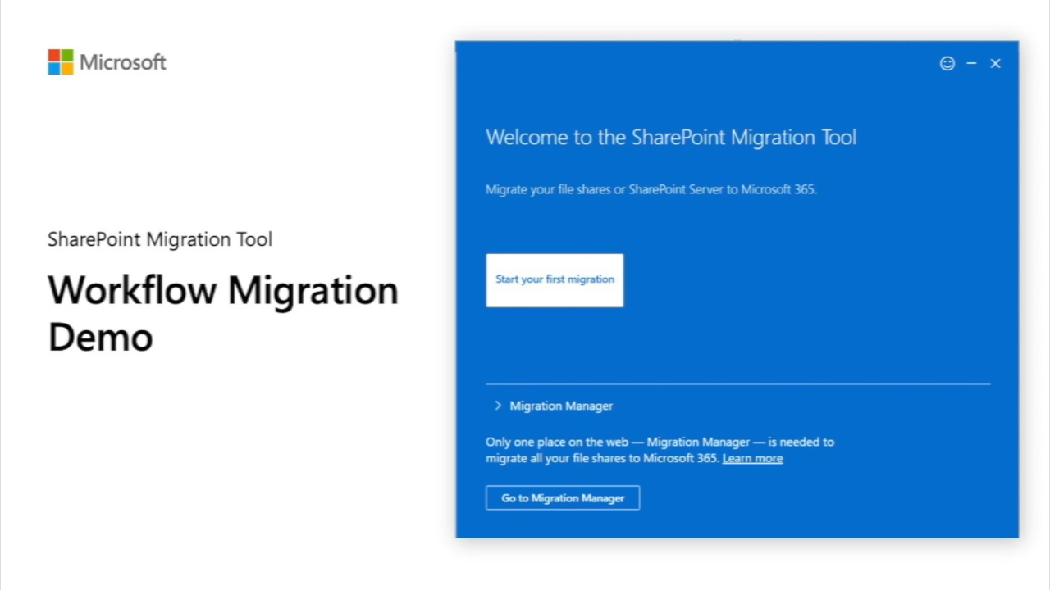
Notes:
Here you go, the video is about 3 minutes long. Can everyone see the video, hear the audio?

Slide 5
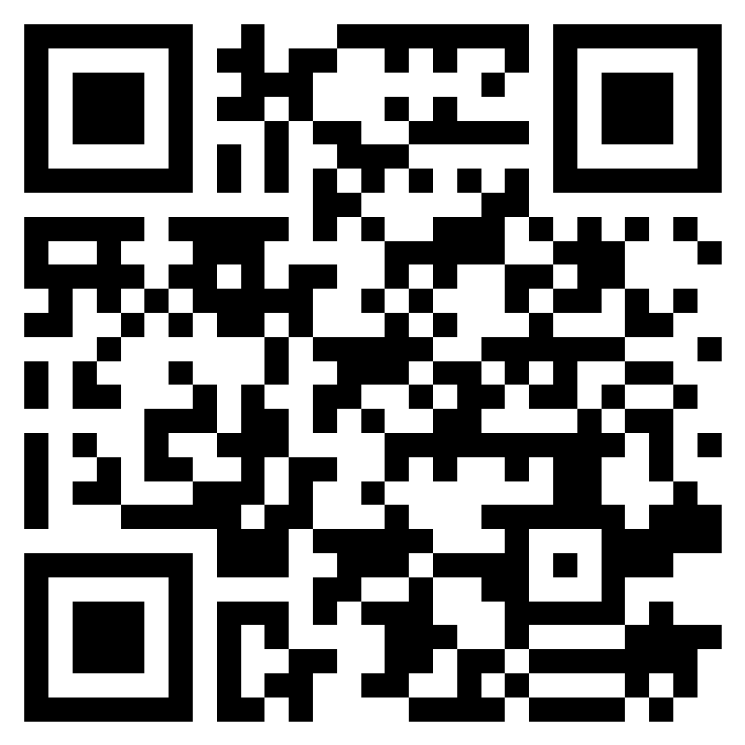
Give a try of migrating your workflow
Link to register for preview build – ask inputs and willingness to try the private preview build.
Start to register before 6/30/222. Download link and user guide will be sent to you after we receive your registration.
Link to official SPMT workflow migration document
Send your questions and requests to zhaosu@microsoft.com
Notes:
As the latest feature of migrating designer workflow is only available in the private preview, we are inviting you to register and play with it. The links are shared in the chat. You can also scan the QR code to fill the form. After you submit the form, we will follow up with you to share the download link, user guide and demo video if you want to watch it again.
This is the end of my demo session. If you have questions, leave it in the chat or send me emails.
Thank you!

